Slide 1
Sets
Chapter 2

Slide 2
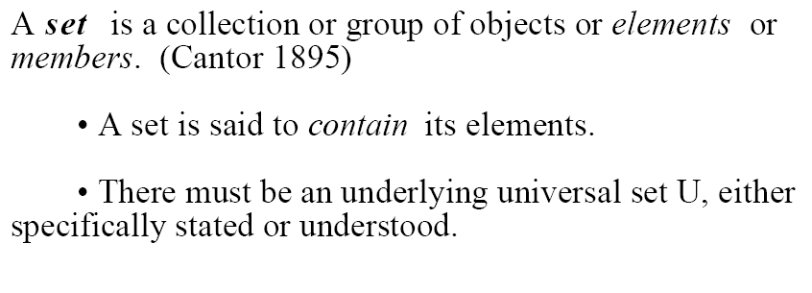
Definition

Slide 3
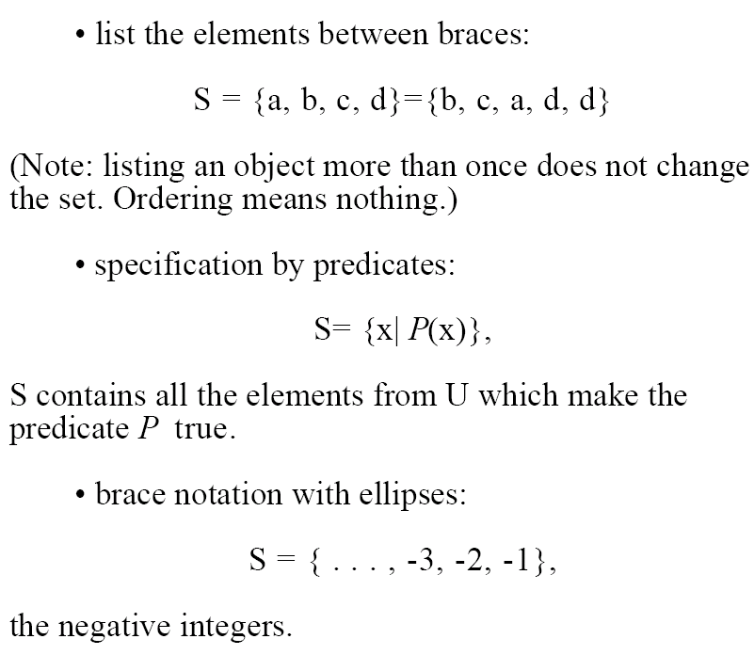
Notation

Slide 4
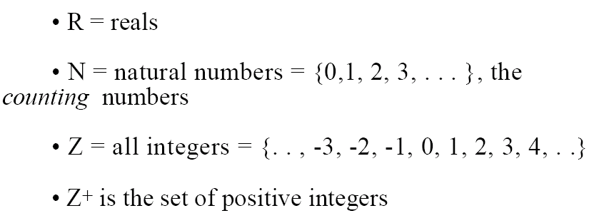
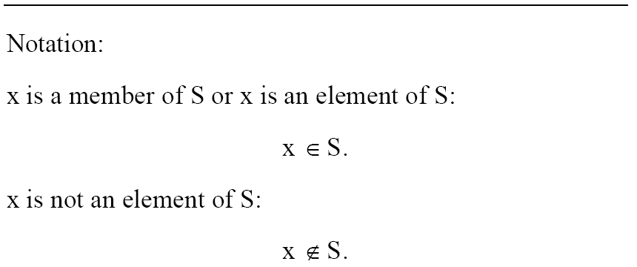
Common Universal Sets

Slide 5
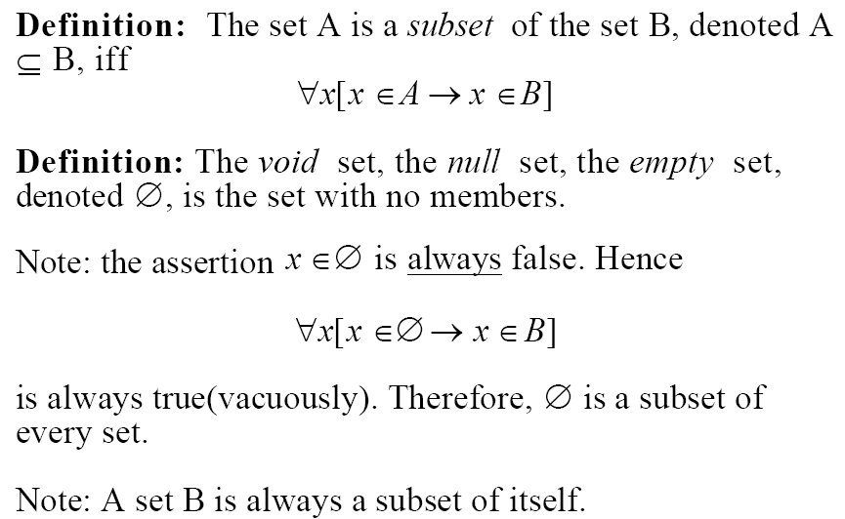
Subsets

Slide 6
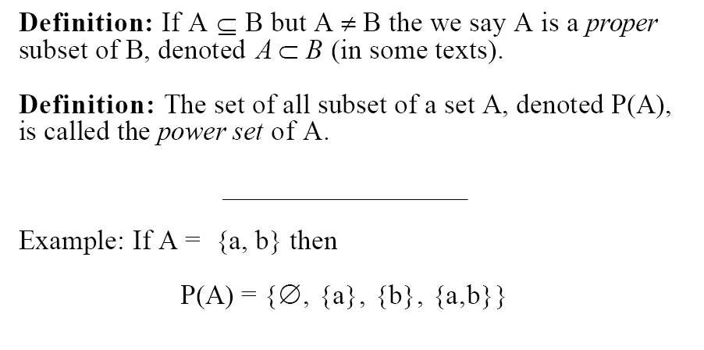
Special Subsets

Slide 7
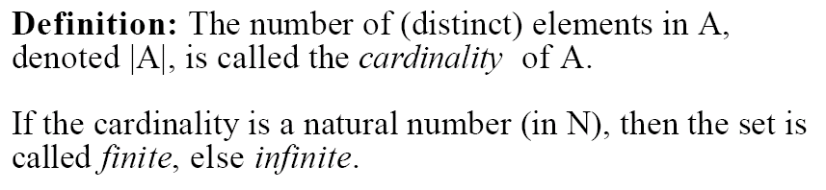
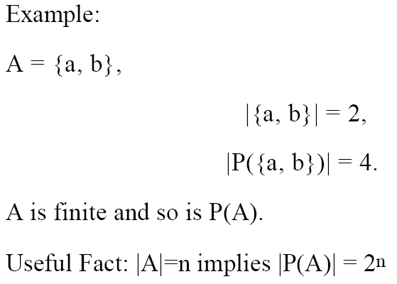
Cardinality

Slide 8
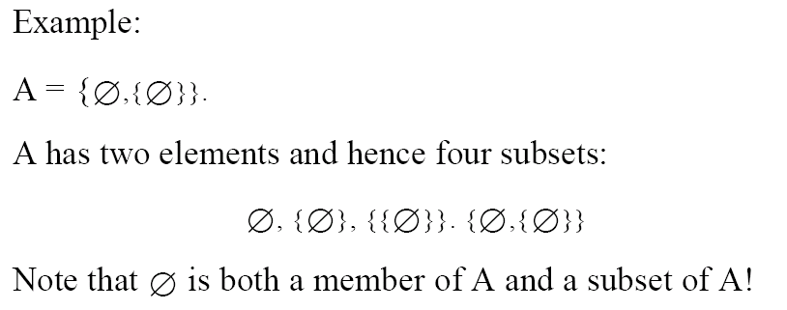
Notes
The power-set of A is often written as 2^{A}
A set can be an element or a subset of another set
Can you write down the power set of A?

Slide 9


Paradoxes ☺

